Slide 1
Gittin’ * DONE
a guide to using Git and GitHub for collaborative data science
by Matt Tranquada

Slide 2
Outline
Review: Git
Review: GitHub
Basic Git/GitHub Workflows
GitHub Collaboration Patterns
Advanced GitHub Development Concepts
Git and GitHub Tips and Hacks for Data Science

Slide 3
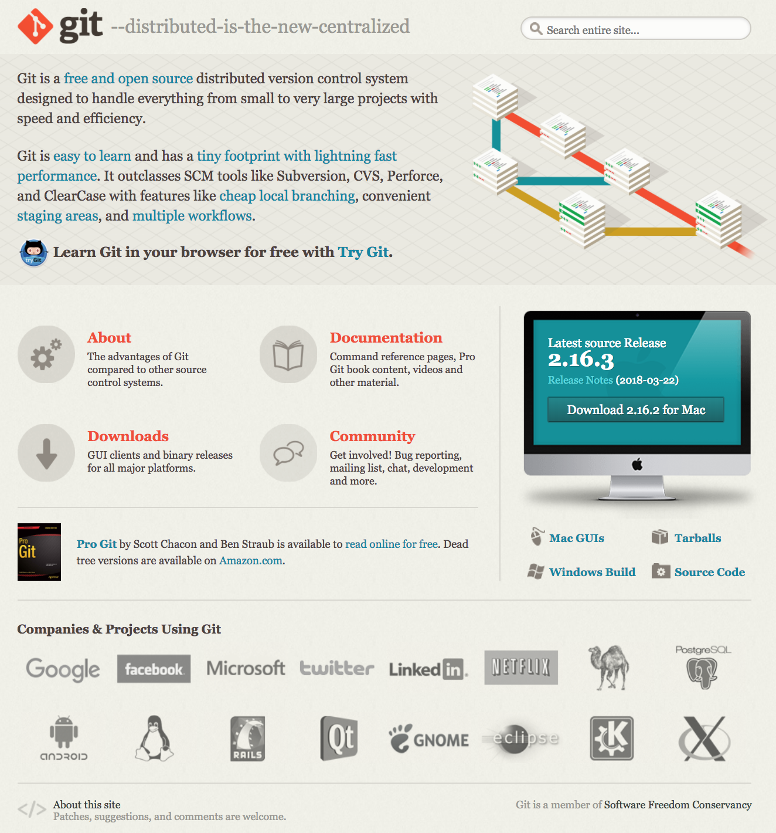
Review: What is Git?
“Git” is a version control system (VCS) originally designed for source code management (SCM) by Linus Torvalds and released in 2005.
Git is a distributed version control system (DVCS), which uses linked remote and local repositories, in contrast to centralized version control systems (CVCS)
CVCS examples: CVS, Subversion, and Perforce
DVCS examples: Git, Mercurial, Bazaar or Darcs

Slide 4
Git Design Goals
Speed – almost all operations done locally
Simple design
Support for non-linear development – up to thousands of parallel branches
Support for fully distributed development
Efficient handling of large projects – both speed and data size

Slide 5
What is special about Git?
Most VCSs store changes to files as a simples series of file changes, typically called diffs for differences (this is called the “delta version control model”) that reference the original file
Git stores changes to files as a stream of snapshots, creating a mini filesystem that stores new versions of files when necessary or else simply links to the previous version if unchanged

Slide 6
KEY GIT COMMANDS
git add
git branch
git checkout
git commit
git config
git clone
git diff
git fetch
git help <verb> / man git-<verb>
git <verb> -h
git init
git log
git mv
git pull
git push
git remove
git reset
git rm
git status
git status –s
git tag

Slide 7
The .gitignore file

Slide 8
Git Resources
“Pro Git” (2nd ed., 2014): https://git-scm.com/book/en/v2
.gitignore files
GitHub reference .gitignore library: https://github.com/github/gitignore
Online gitignore generator: https://www.gitignore.io/

Slide 9
GitHub Resources

